Slide 1
Mastermind Code Kata Thoughts
Joe Berg
(He/Him)
github.com/mathematicaljoe/Mastermind

Slide 2
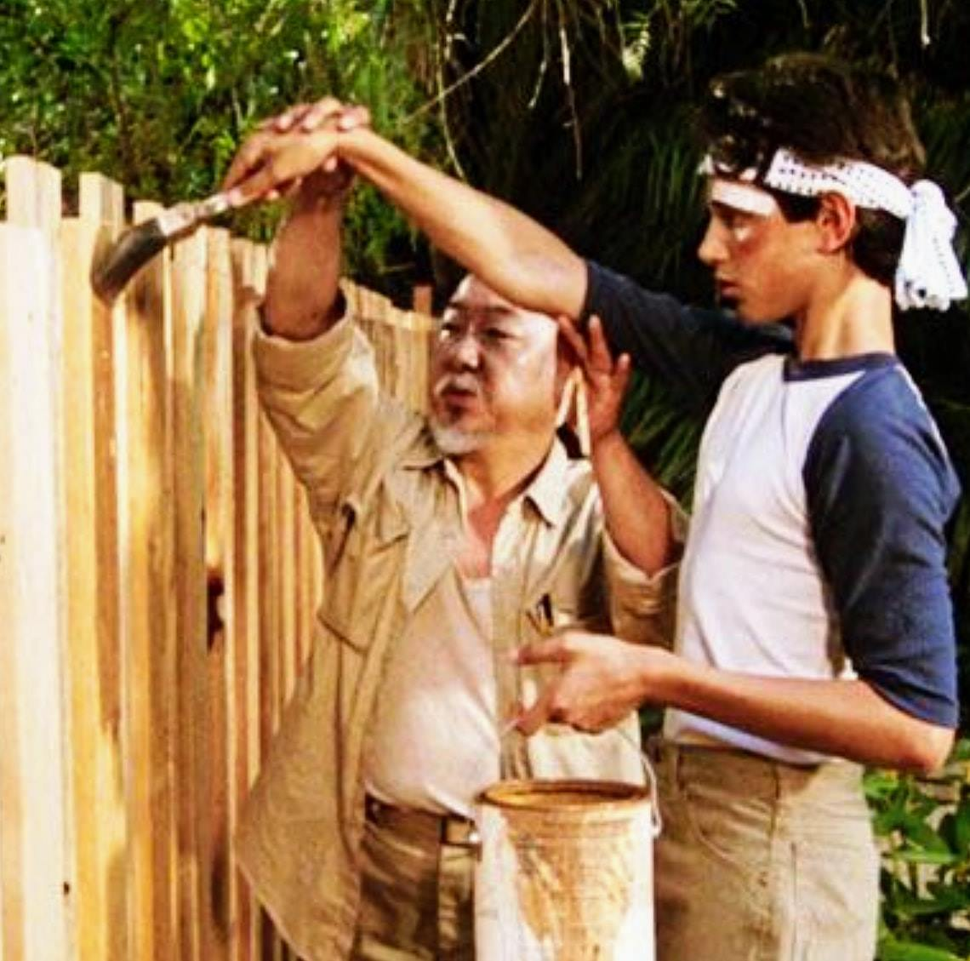
Code Katas
Oxford Languages Definition for “Kata”: An individual training exercise in karate and other martial arts.
“Code Kata”: Is the same thing but in software development and engineering.
Often associated with the Test Driven Development/Agile/Clean Code movement(s).

Slide 3
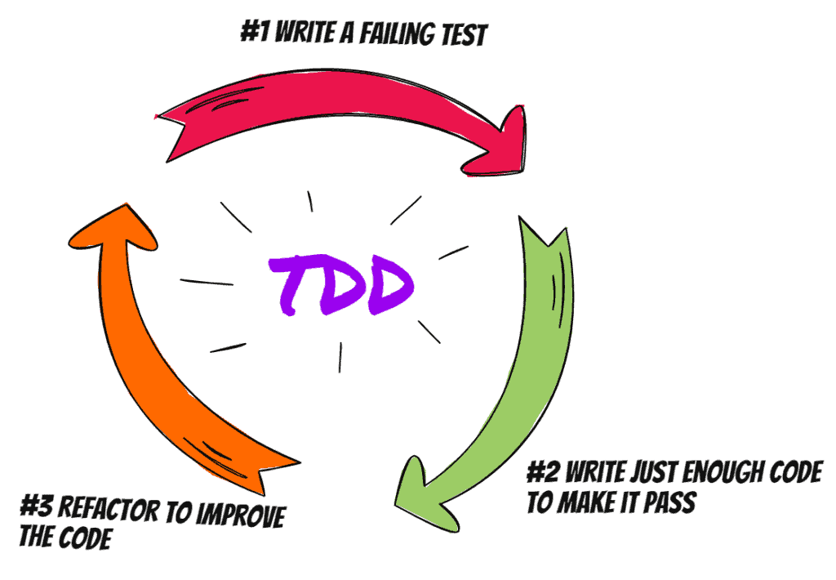
Test Driven Development
Red – Write a little test that doesn’t work, and perhaps won’t even compile at first.
Green – Make that test work quickly, committing whatever sins necessary in the process.
Refactor – Eliminate all of the duplication created in merely getting the test to work.
See Test-Driven Development by Example – Kent Beck
Notes:
Great way to start writing more tests
Perhaps over tests some things (must be careful about testing only the interface, not the implementation)
All dependency makes code harder to change. Don’t want that.
Some measures of changeability even just count incoming dependencies (see: Clean Archetecture, Uncle Bob)

Slide 4
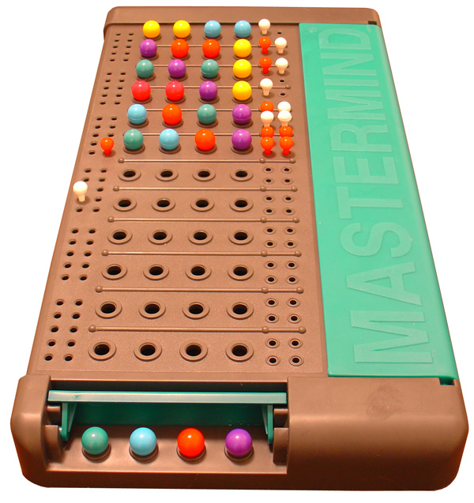
Mastermind
0 Right Color Right Position
1 Right Color Wrong Position
1 Right Color Right Position
1 Right Color Wrong Position
Code Breaker Guesses
There are pegs of 6 colors.
The ‘Code Maker’ picks a “code” consisting of 4 such pegs
The ‘Code Breaker’ guesses a code.
The Code Maker tells the Code Breaker 2 things:
The number of pegs in the guess that are the right color and in the right position.
The number of pegs in the guess that are the right color and in the wrong position.
Example
Code: GPRR
Guess: PRRY
Right Color Right Place: 1 (The “R” highlighted in red)
Right Color Wrong Place: 2 (The “P” and “R” highlighted in blue)
Full Rules: https://magisterrex.files.wordpress.com/2014/07/mastermindrules.pdf
Code Maker Code
Hidden From Code Breaker

Slide 5

Quick Overview Of Code
https://github.com/mathematicaljoe/Mastermind

Slide 6

Things To Talk About The Current Setup
Ubiquitous Language Use
The language used in the code and the language used in the rules/game documentation is the same.
Language From the Rules: “right color and in the right position”
Function in the Code: “RightColorRightPosition(…)”
There is essentially no cost in translating the business logic of the code to the language that a non-code savvy domain expert would use.
“The model based language should be used among developers to describe not only artifacts in the system, but tasks and functionality. The same model should supply the language for the develops and domain experts to communicate with each other, and for the domain experts to communicate among themselves about requirements.” - Domain-Driven Design,
Eric Evans

Slide 7
Functional Core – Imperative Shell Architecture
As much code as possible has a functional interface.
All I/O and non-functional code are high in the dependency chain.
The imperative code “surrounds” the functional “core”.
Functional interfaces are easier to understand, easier to test and easier to change.
Functional Core is not allowed to depend on Imperative Shell.
Imperative Shell
Functional Core
Notes:
Most of the domain code goes in the core.
Functional Code is easier to test and understand so we’d like as much of it as possible.
Similar Things/Names: Hexagonal Archetectur, Clean Archetecture
Dependencies are the assumptions that modules make about each other – Parnas (not perfect quote, off the top of head)

Slide 8
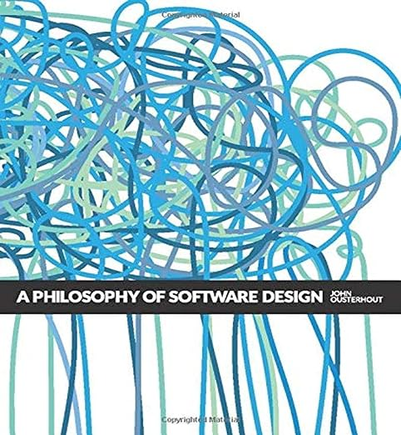
Define Errors Out Of Existence
I started using std::string for the code, with chars “roygbp” as the “colors”.
I found that I wanted to write a lot of error checking code for checking that the string was a valid code.
The precondition section of every contract had a line like: “Behavior of this function is undefined unless the code is 4 chars long and the chars are valid colors.”
Adding a color enum and changing the code to be std::array<Color, 4> ‘defined some of these errors out of existence’
See A Philosophy Of Software Design – John Ousterhout
Notes:
Can we refactor and/or change the abstractions a bit to have this not be an error?
Even loosening preconditions can be good
Another example is passing references instead of pointers and checking for null
Note: Enum is only kinda safer than chars, since valid values are anything that can fit in the int that represents the enum

Slide 9

Future Possibilities and Considerations
Katas can be very simple, but often they are good tools to consider/discuss/practice larger designs.

Slide 10
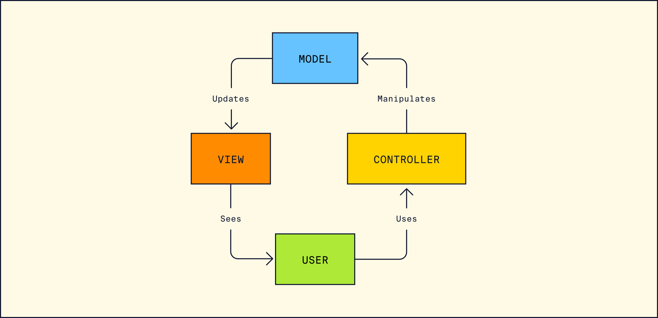
Model-View-Controller
A Design Pattern that separates
The “View” - Code that Handles the User Interface. Think GUIs and TUIs
The “Controller” - Code that receives and handles User Input. Think Keyboard and Mouse Listener
The “Model” - The domain model of the application.
https://www.codecademy.com/article/mvc
Notes:
Don’t have View and Controller have a cyclic dependency (Think about having one Gui that takes input and provides output). You are either using the escalation or demotion levelization technique to avoid that (All the Lakos Large Scale c++ books talk about levelization). It’s potentially ok to have the controller know about the view (so no dependency loop), probably want to limit that interaction to things that are specific to the certain setup (Only Gui specific things) you don’t want all controllers to know about all views. Be careful with the contracts and dependencies if you do that (a multiple interface situation).

Slide 11
HighFidelityModel
LowFidelityModel
FakeModel
WindowsGuiView
CommandLineController
TuiView
KeyboardHotKeys
Controller
WebGuiView
Gui Controller
LoggingView
PrespecifiedInput
Controller
FakeView
FakeController
Notes:
We could even add components in different programming languages (WebGuiView can be in Web Dev langauges, Windows can be in C#, …)
Note: Each component is can encapsulate it’s dependencies. The KeyboardHotKeysController knows about Keyboards and uses libraries for interacting with keyboards for its implementation and tests. No other components need to rely on these keyboard interaction libraries.
Note: For the Mastermind Game, I’m imagining these elements communicating through some sort of PubSub/Messaging Interface. That would make adding multiple components of the same type easy (ie. The GuiController allows clicks in the GUI, and the KeyboardHotKeys Controller allows key clicks to control the same program.

Slide 12
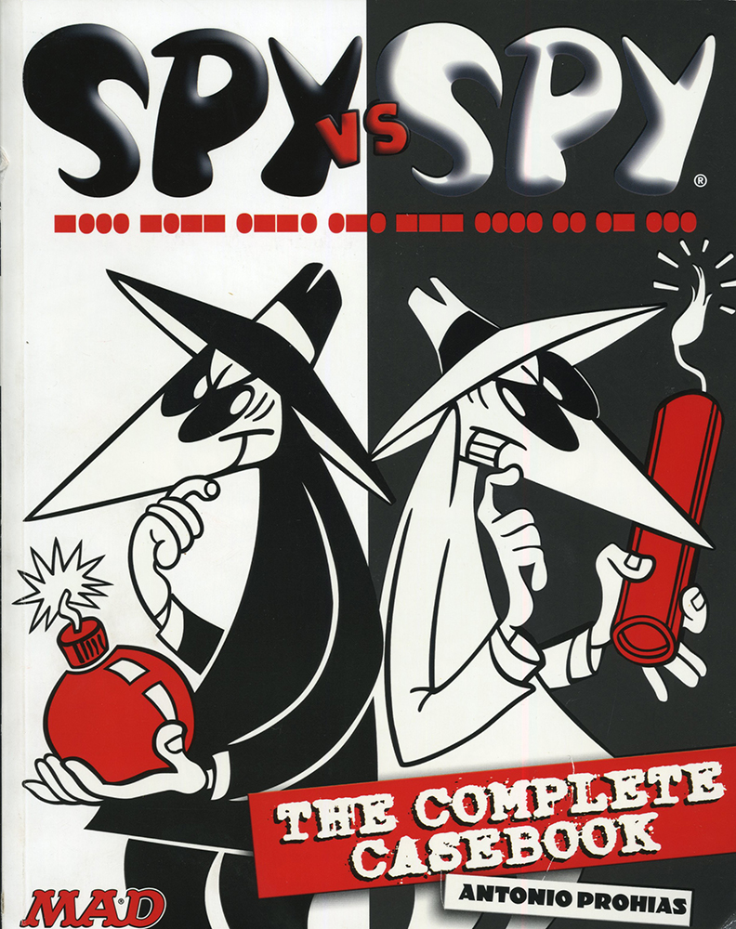
Test Doubles
A fake is a lightweight implementation of an API that behaves similar to the real implementation but isn’t suitable for production; for example, an in-memory database.
Stubbing is the process of giving behavior to a function that otherwise has no behavior on its own—you specify to the function exactly what values to return (that is, you stub the return values)
Interaction testing is a way to validate how a function is called without actually calling the implementation of the function. A test should fail if a function isn’t called the correct way—for example, if the function isn’t called at all, it’s called too many times, or it’s called with the wrong arguments.
From: Software Engineering at Google – Winters, Manshreck and Wright
https://abseil.io/resources/swe-book/html
Notes:
Stubbing:
Every test has extra code (defining the stubs behavior),
Which functions a function calls and how are implementation details, stubbed tests break for implementation changes
Stubs and Real implementations can differ without you being able to know, fakes are easier to test
Lots of places to change when the implementation changes (only one for the fake).

Slide 13
Test Doubles Recommendations
Prefer Realism Over Isolation, and real implementation should be preferred over a test double.
A fake is often the ideal solution if a real implementation can’t be used in a test.
Overuse of stubbing leads to tests that are unclear and brittle.
Interaction testing should be avoided when possible: it leads to tests that are brittle because it exposes implementation details of the system under test.
From: Software Engineering at Google – Winters, Manshreck and Wright
Notes:
This is 1 of 4(?) very good chapters on testing in that book.

Slide 14
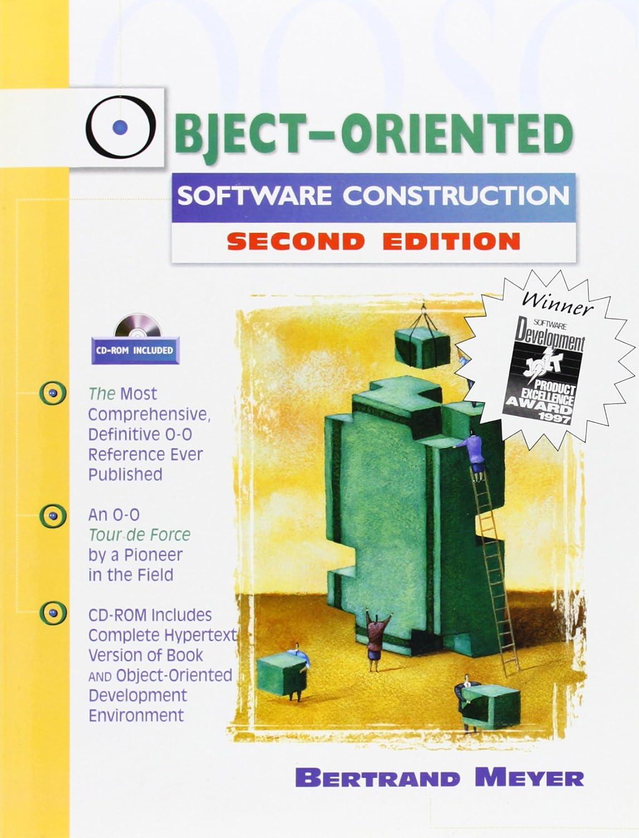
Liskov And Contracts For Polymorphism
The Liskov Substitution Principle is a necessary but not sufficient condition for a polymorphic construct to be less complex than handling the potentially polymorphic items individually.
Liskov says that the user of the polymorphic construct should never have to ask or know which member of the polymorphism it is interacting with.
A good way to do this is to have explicit contracts that members of the polymorphism must abide by. This includes pre-conditions and post-conditions of operations and general invariants.
Then write tests that can be applied to members of the polymorphism that test the contract.
Notes:
The polymorphism is an extra layer of abstraction and complexity that is supposed to hide which type is actually being used. So users of the polymorphism only need to know about 1 type instead of n types. If Liskov isn’t followed then users of the polymorphism need to understand n+1 types.

Slide 15
End

Slide 16
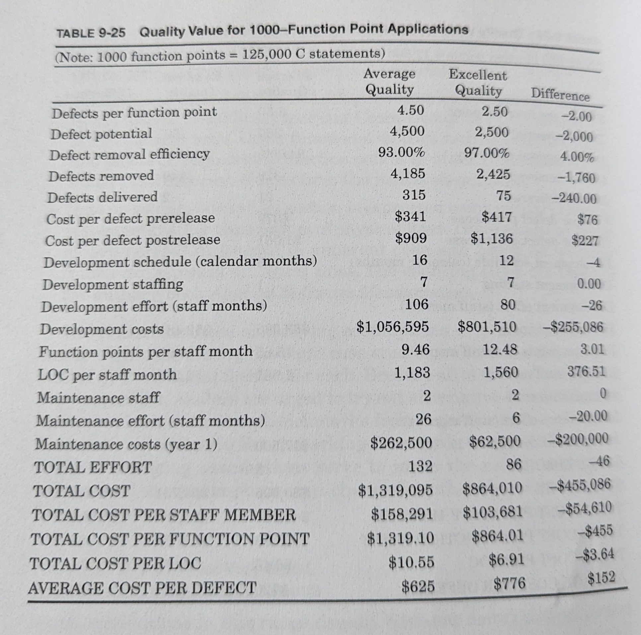
Appendix – The Positive Correlation of Quality and Productivity
“Between 30 and 50 percent of every dollar ever spent on software has gone to finding and fixing bugs.” – Capers Jones, Software Engineering Best Practices
“For small applications of 1000 functions points, quality starts to become very important” – Capers Jones, Software Engineering Best Practices
Software Engineering Best Practices - Capers Jones

Slide 17
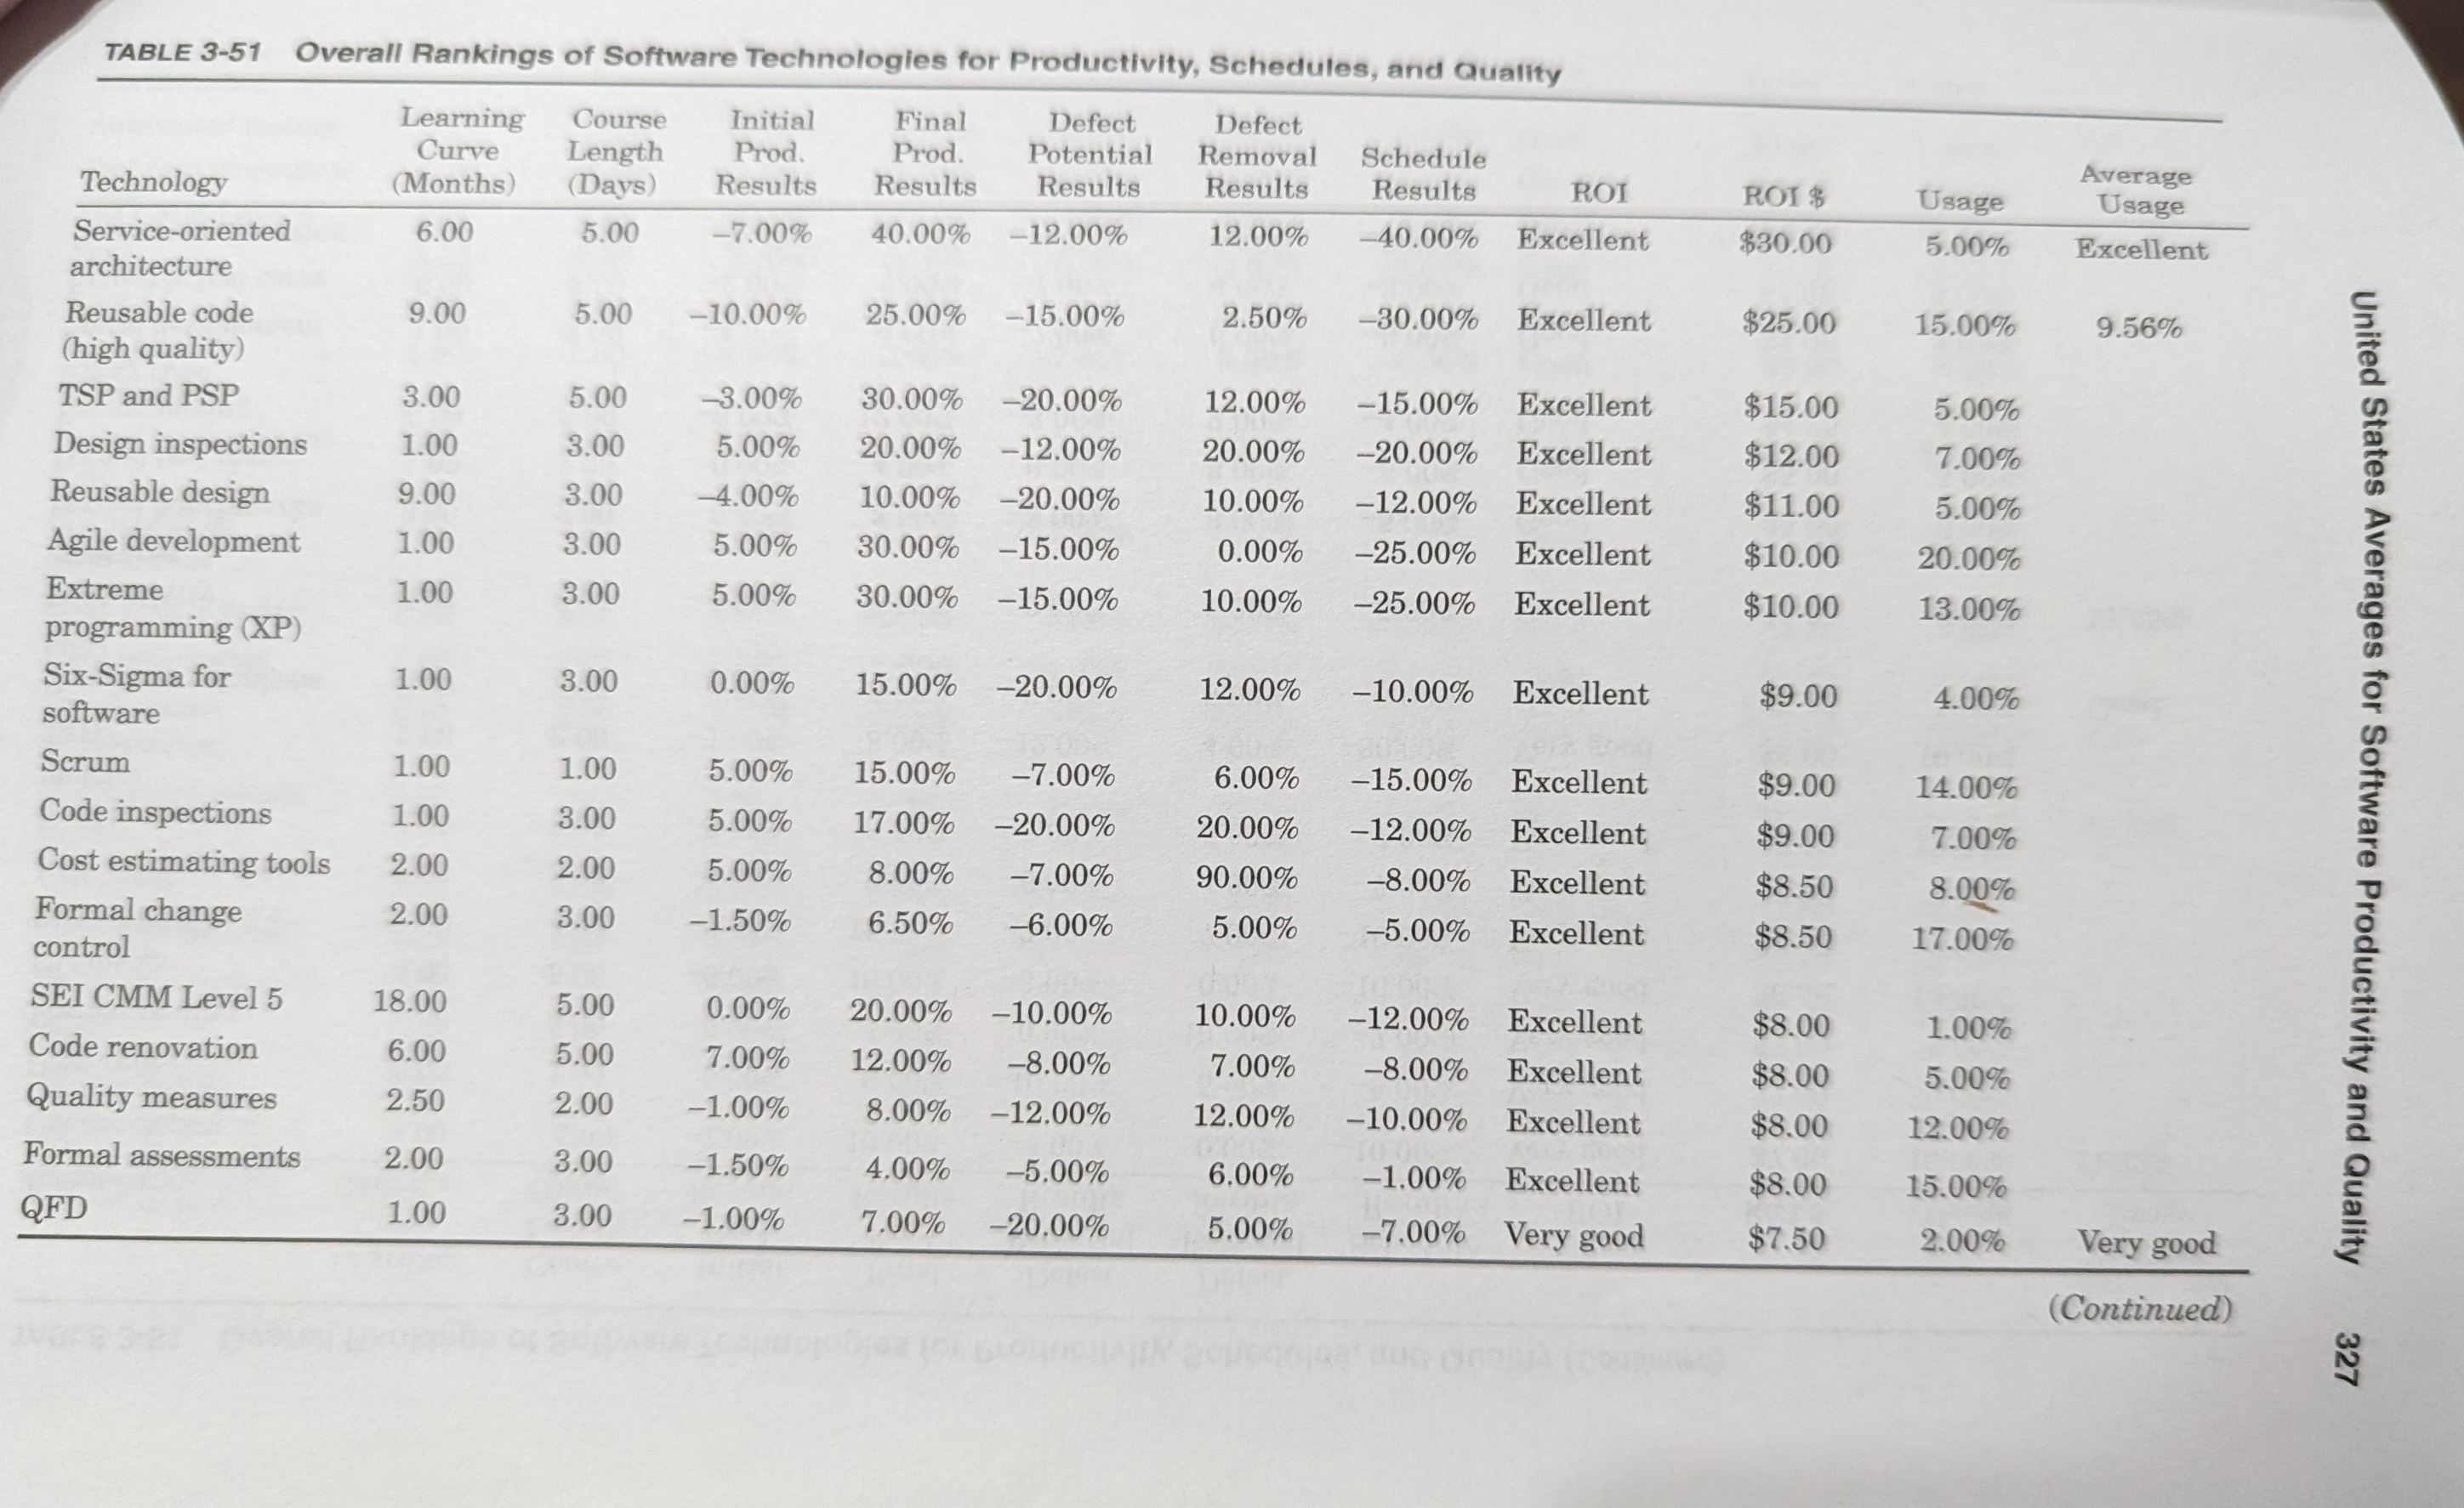
Applied Software Measurement, 3rd Edition – Capers Jones
Notes:
Service –oriented architecture (think micro-service)
Personal Software Process, and Team Software Process. Structured software dev process that is intended to help software engineers understand and improve their performance by using a “disciplined data-driven procedure”.
SEI CMM Level 5 (Software Engineering Institute (Carnigie mellon) Capability Maturity Model) – It is a framework that is used to analyze the approach and techniques followed by any organization to develop software products.
QFD = quality function deployment is a process and set of tools used to effectively define customer requirements and convert them into detailed engineering specifications, and plans to produce the products that fulfill those requirements

Slide 18
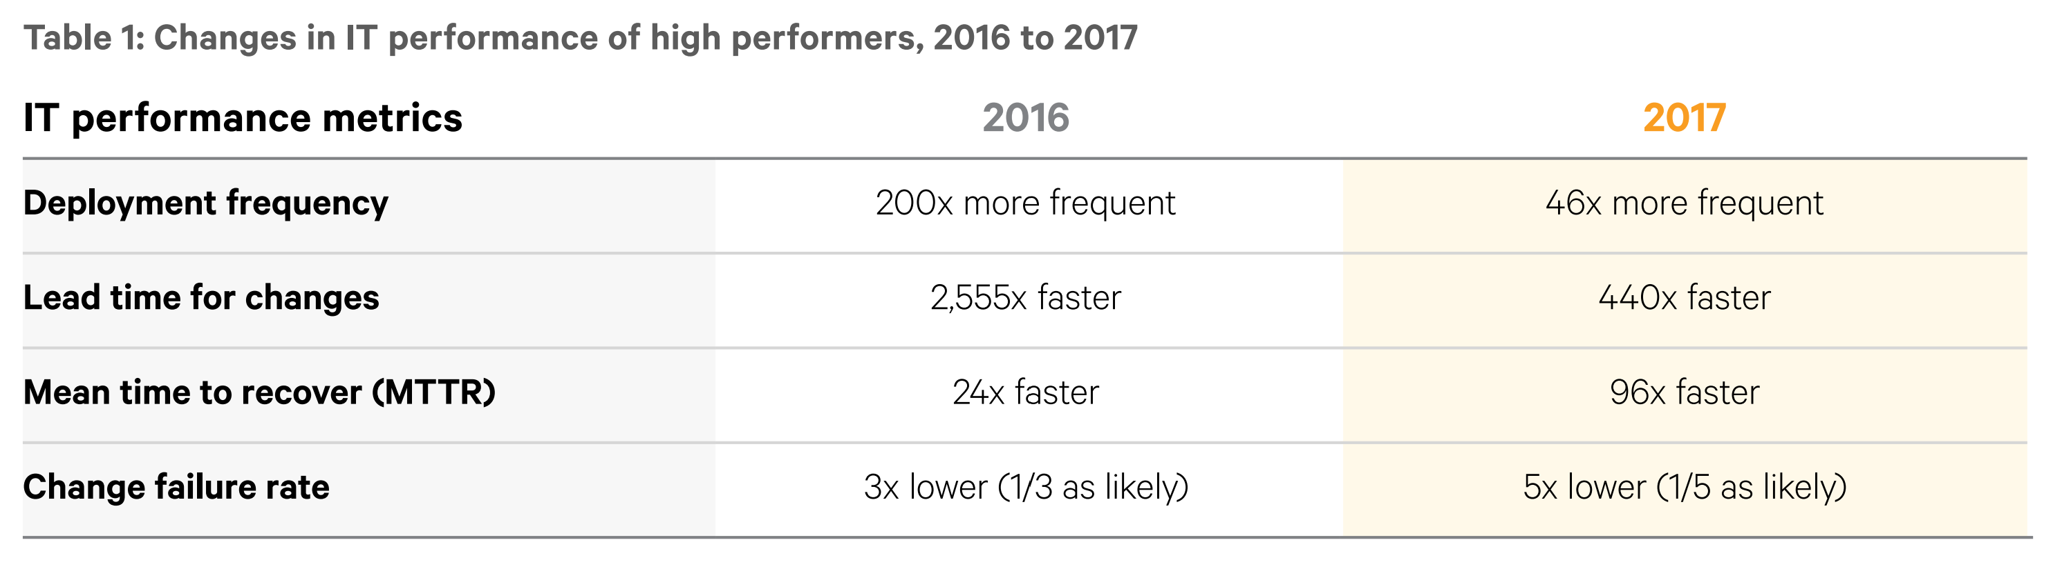
“These results demonstrate that there is no trade-of between improving performance and achieving higher levels of stability and quality. Rather, high performers do better at all of these measures. This is precisely what the Agile and Lean movements predict, but much dogma in our industry still rest on the false assumption that moving faster means trading off against other performance goals, rather than enabling and reinforcing them.” – Accelerate, Forsgren, Humble, Kim (See State of Devops Reports 2017 for chart)

Slide 19
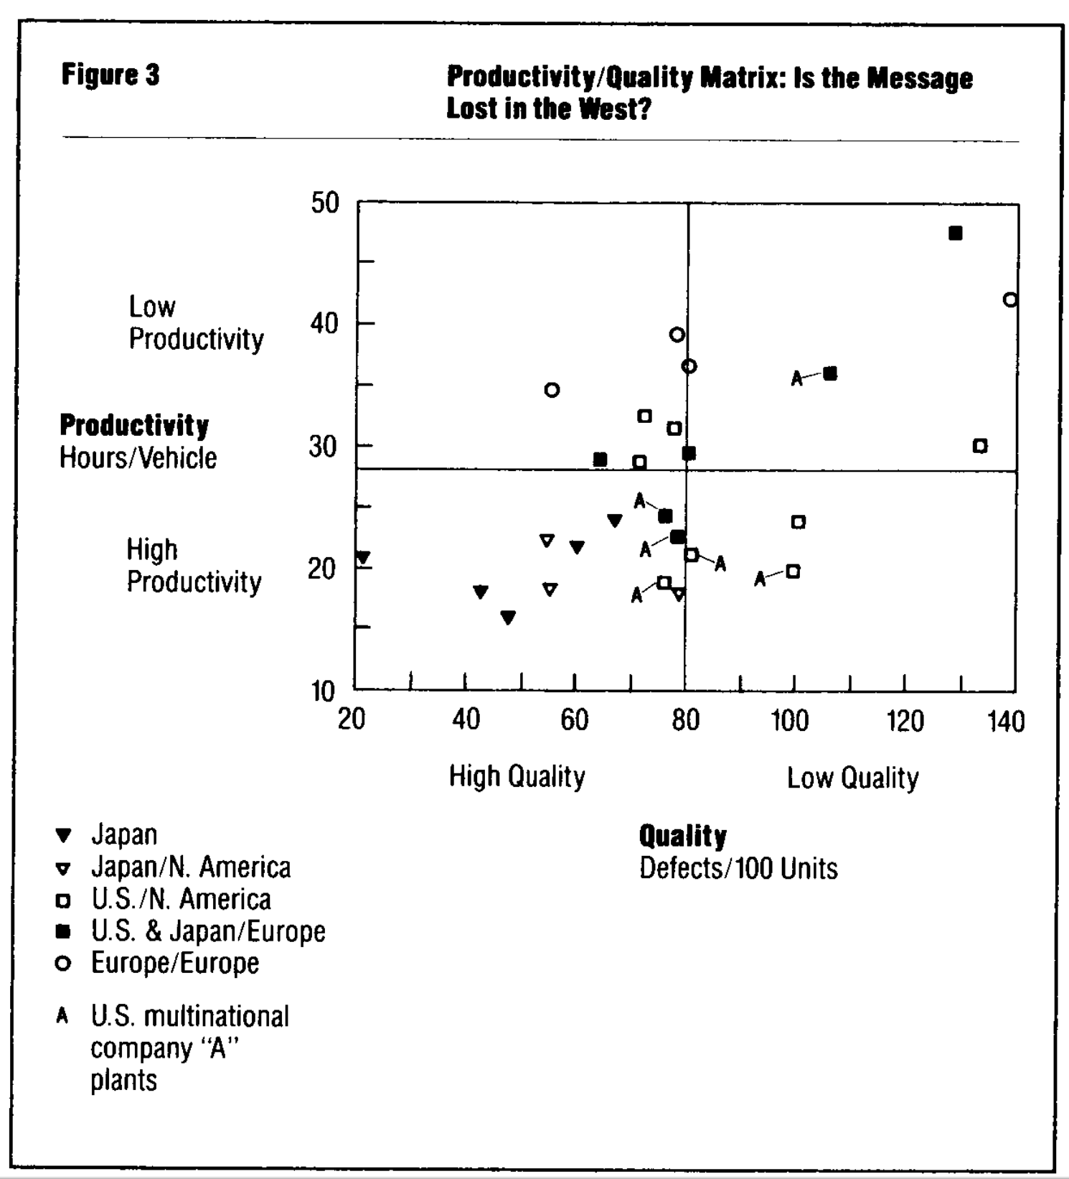
That there is a strong correlation between quality and productivity should not come as a surprise. The quality gurus of the industry – Juran, Deming, Crosby, and others – have all espoused the “Quality Is Free” doctrine, the view that productivity tends to increase with improved quality because of reduced rework efforts, more attention to process controls, less inspection requirements, and the like. To a healthy degree of correlation (R = 0.60), those plants producing high-quality products are doing so with substantially less effort than low-quality plants. When looked at from a worldwide perspective, there does not appear to be a tradeoff between quality and prouctivity.
The Triumph of Lean Engineering - Krafcik, John F. Sloan Management Review; Fall 1988; 30, 1; ABI/INFORM Global

